Slide 1

The Power of Opaque Products in Pricing
Adam N. Elmachtoub, Michael L. Hamilton
Department of IEOR
Data Science Institute
Notes:
Be sure to say a short bio about yourself
“My name is Michael Hamilton, I’m a phd at Columbia University IEOR where I’m advised by Adam Elamchtoub,
I’m interested in problems in revenue management and pricing, especially pricing problems that crop up in online marketplaces”

Slide 2
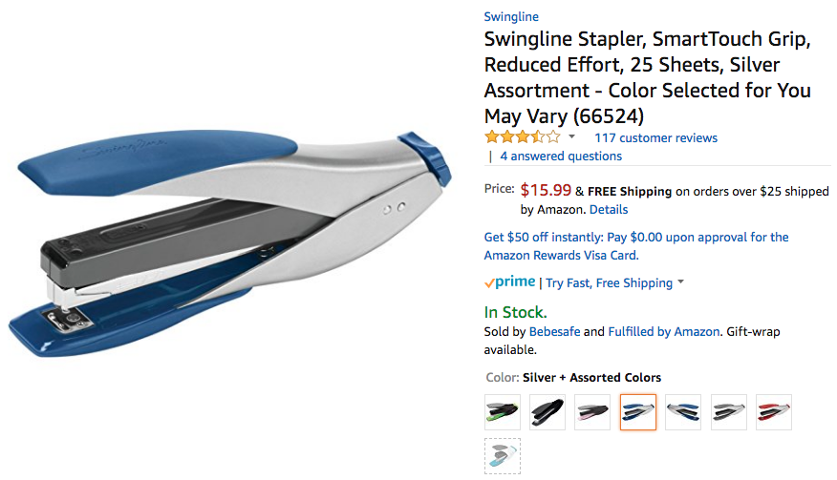
Opaque Selling (OPQ)
An opaque product is a discounted product where a feature is hidden from the customer until after purchase.
Notes:
Important thing to note, is that you can buy it in red, blue, etc. What’s interesting is there’s this “Color … You” option, etc…

Slide 3
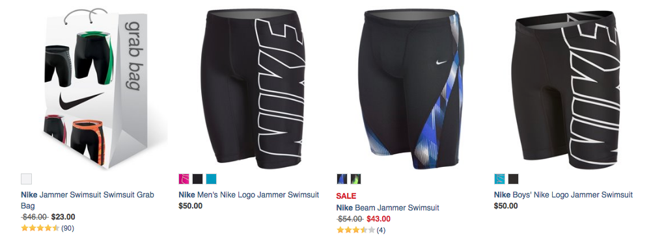
Opaque Selling (OPQ)
Opaque Product
Traditional Products
Notes:
Here we have another example of opaque selling. I took a screen grab from an website called swim outlet, which sells swimming gear and accessories. In particular they sell swim ”jammers” in various brands. What I want to highlight here is that typically opaque products are offered alongside their transparent counterparts

Slide 4
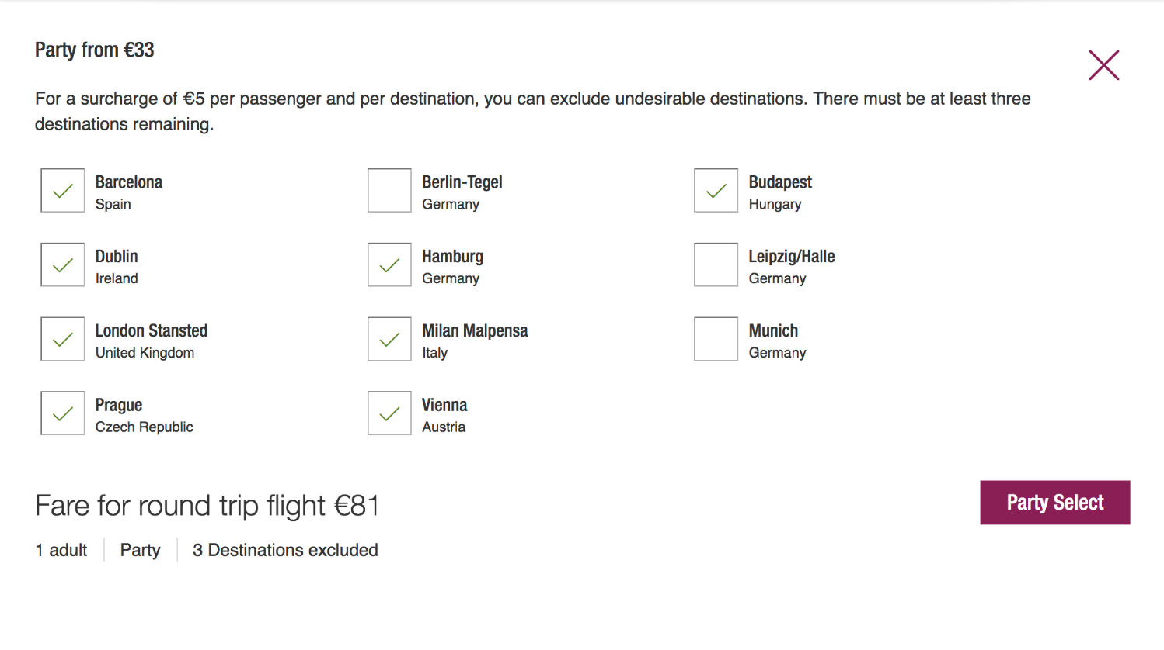
Opaque Selling (OPQ)
€121- 5 · # Outcomes
We call an opaque product over the customers favorite k outcomes k-opaque.
Notes:
Mention that not all opaque products aren’t created equal, we can think of how opaque a product is by the number of possible allocations are associated with it…
Also point out the clever UI-X, we will use this paradigm

Slide 5
Opaque Selling (OPQ)
Selecting eight possibilities is a 8-opaque product.

Slide 6

Opaque Selling (OPQ)
Selecting nine possibilities is a 9-opaque product.

Slide 7

Opaque Selling (OPQ)
Selecting ten possibilities is a 10-opaque product.

Slide 8
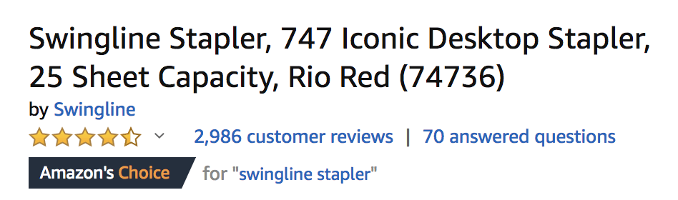
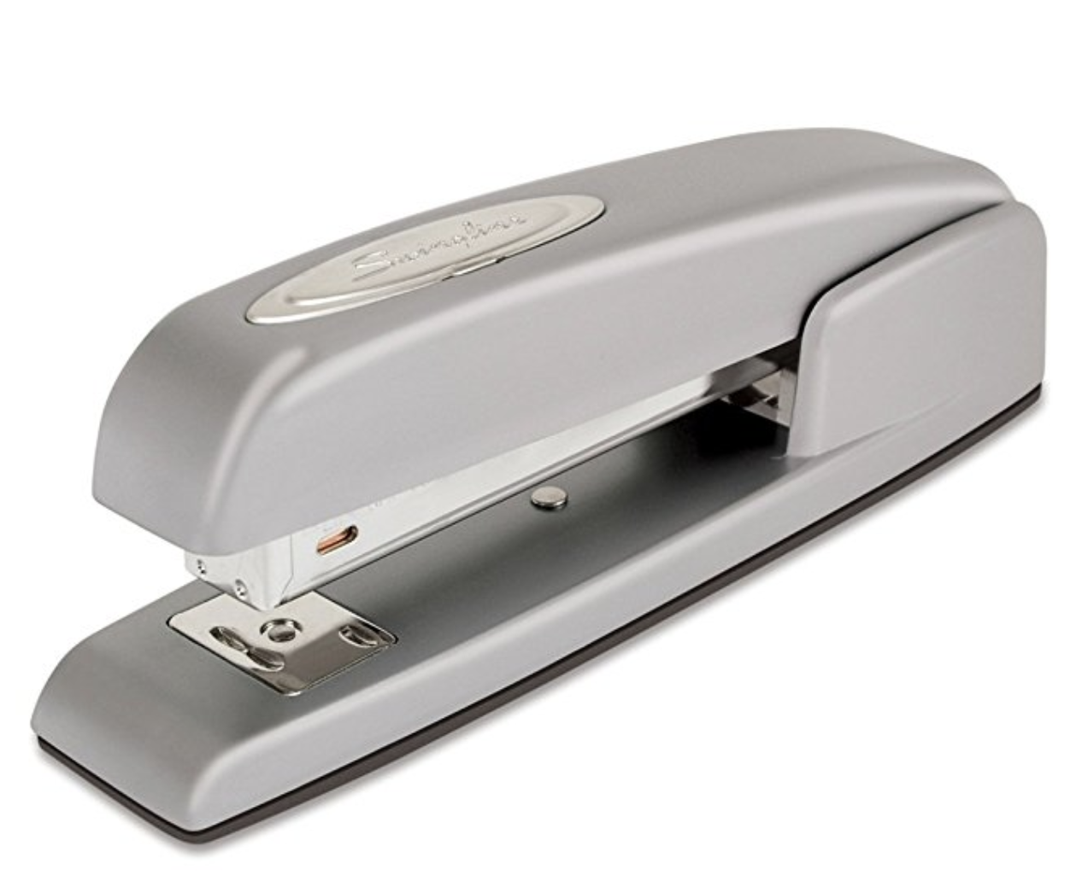
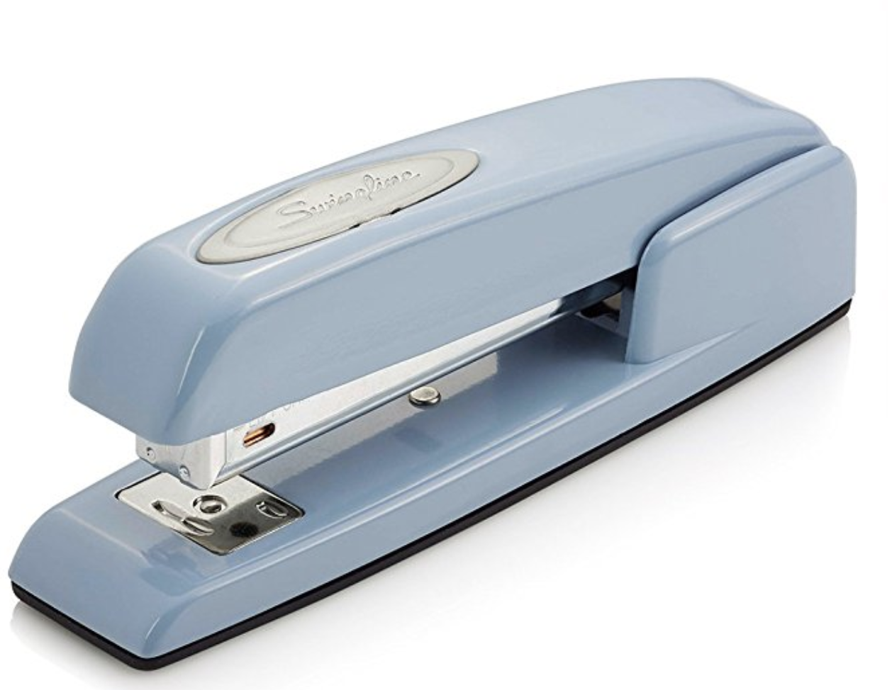
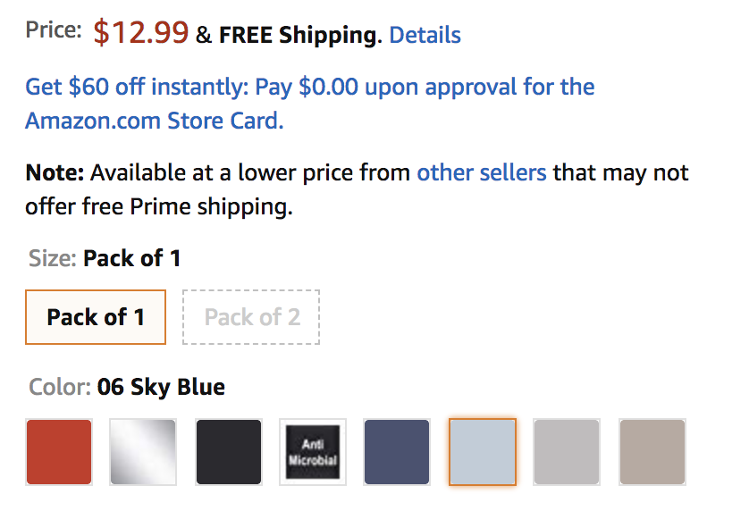
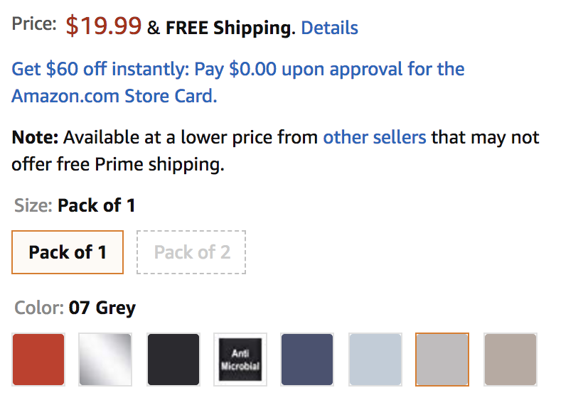
Discriminatory Pricing (DP)
Notes:
So that’s what Opaque selling is. However, since it is my intetion to convince you it should be considered as a price discrimination tool when selling horizontally differentiated goods; I should tell you what the alternatives are. In particular
Opaque selling is not the only way to pricing discriminate when selling substituable goods… One common way to do this is to simply vary the prices. Here we have our previous version of the stapler the price varies pretty wildly based on color

Slide 9
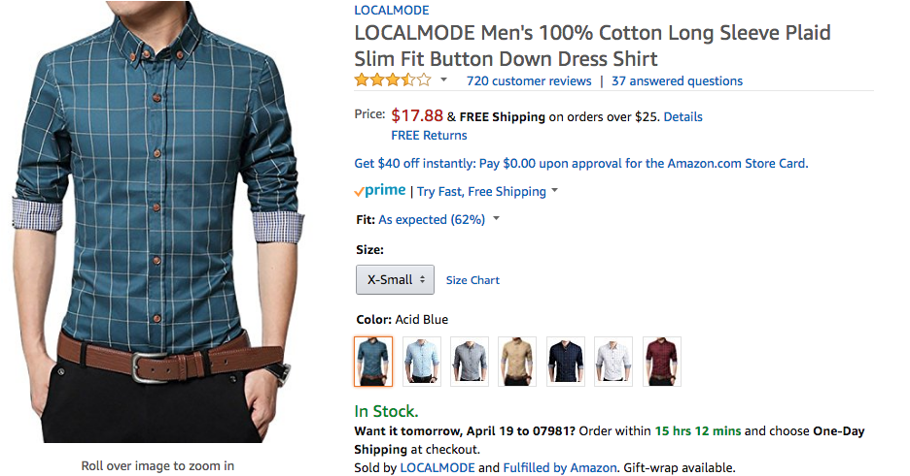
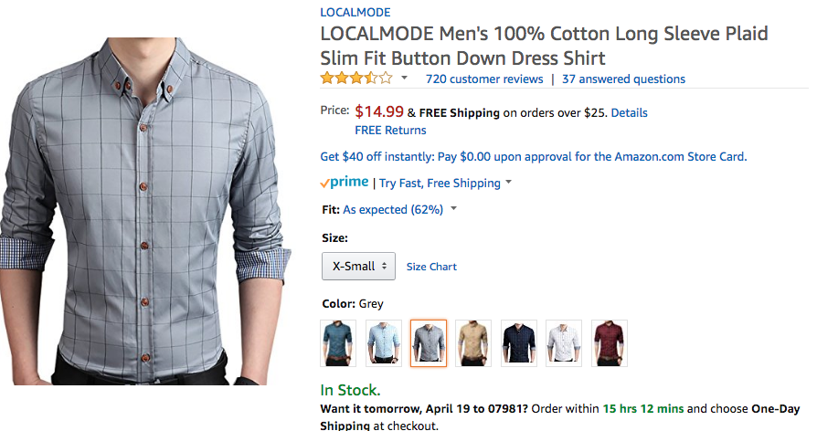
Discriminatory Pricing (DP)
Notes:
There are lots of examples of discriminatory pricing on Amazon

Slide 10

Discriminatory Pricing (DP)
Can greatly increase seller revenue.
Even when product valuations are drawn symmetrically (i.e. i.i.d.).
Discriminates against particular segment of customers.
Since goods are of equal quality, some goods are arbitrarily higher priced.
Notes:
It may seem sort of counter initutive that we’d offer substitutable goods are differing prices.
As it turns out in theory non-convex here, don’t stress fairness.
On a gut level though I believe this feels sort of wrong.
Be sure to emphasize in words why I give a shit
OPQ selling sides steps these and has a nice properties!

Slide 11



Research Thesis
A seller offering substitutable goods
$ 11
$ 9
$ 14
can side step the drawbacks of discriminatory pricing
by using opaque products to create vertical differentiation
$ 14
$ 11
$ 9
?
x
?
x
x
x
x
x
while garnering comparable or more revenue.
Click 1
Click 2
Click 3
Notes:
Highlight in particular, we will use discriminatory pricing as a our point of comparison and our goal is show we can do as well or better using opaque goods.
Opaque selling has

Slide 12
Contributions
Characterize when opaque selling earns more revenue than discriminatory pricing.
Show when valuations are simple, a single opaque product guarantees most of the revenue.
Quantify the potential revenue lift from utilizing opaque products.
Notes:
Characterize fairly broad conditions when we can guarantee opaque selling earns more revenue than disc.
In fact we will show that, when valuations are simple, sellers offering only a single opaque product can enjoy nice revenue guarantees
Beyond guarantees, we will demonstrate that sometimes opaque selling can signifigantly

Slide 13
Related Literature
Opaque Selling
Algorithmic Pricing
Opaque Selling as Inventory Management
Gallego and Phillips (2004) , Gallego et al. (2004)
Fay and Xie (2014)
Xiao and Chen (2014)
Elmachtoub and Wei (2015)
Opaque Selling Applications
Guarantees for Discriminatory Pricing
Simple and Approximately Optimal Mechanisms
Briest et al. (2015) and Hart and Nisan (2014)
Briest and Roglin (2010)
Celis et al. (2014), Ma and Simchi-Levi (2016),
Abdallah et al. (2017)
Chawla et al. (2007), Chawla et al. (2010) , Chawla et al. (2015)
Cai and Daskalakis (2011)
Chen et al. (2018)
Competition. Shapiro and Shi (2008), Jerath et al. (2010)), Jiang (2007) and Fay and Xie (2008)
NYOP. Chen et al. (2014), Huang et al. (2017)
Queuing. Xu et al. (2016), Geng (2016), Post and Spann (2012)
Mechanism Design Pavlov (2011), Balestrieri et al. (2015), Balestrieri and Izmalkov (2016)
Notes:
We’re not the first people to study opaque selling, there’s an emerging literature on the topic.
In particular there’s a strong stream of literature about opaque selling as an inverntory management tool. The idea being every sale of an opaque product gives you some power to choose the allocation, and thus balance your inventory. We differ from that literature by focusing almost exclusively opaque selling as a revenue management tool
In general in this work we wish answer questions arising from OM using tools from the theoretical computer science and economics literature

Slide 14
Model

Slide 15




Discriminatory Pricing Model
N different products
Customers draw valuations (V₁, V₂, .., V_{N}) ~ F
Purchase item that maximizes utility: V_{i} - p_{i}
$ p₁
$ p₂
$ p₂
V₁ , V₂ ,V₃
F
Notes:
We’re going to imagine every customer as having some valuations for the N products, i.e. different colors of the same good.
We will assume these valuations are drawn from some distribution that discribes the market, F

Slide 16

Discriminatory Pricing Model
N different products
Customers draw valuations (V₁, V₂, .., V_{N}) ~ F
Purchase item that maximizes utility: V_{i} - p_{i}
$ 5.99
$ 2
$ 5
5 , 3 , 7
F
Notes:
And customers will purchase the item that maximizes their utility, or no item if all utilities are negative

Slide 17
Benefit of Discriminatory Pricing
2 different products
Customers draw valuations i.i.d. according to:
1 w.p. 2/3
$ 1
$ 1
V_{i} =
2 w.p. 1/3
(1 , 2)
(2 , 1)
(2 , 2)
(1 , 1)
E[Revenue(1,1)] = 1
Notes:
In this model, the measure we’re interested in is expected revenue earned where the expectation is taken with respect to the valuation distribution.
Suppose the prices for the two shirts were (1,1). Then every customer would purchase, two such customers being totally indifferent to which shirt they obtain

Slide 18
Benefit of Discriminatory Pricing
E[Revenue] = 1.99・(1-4/9)
≅ 10/9
2 different products
Customers draw valuations i.i.d. according to:
1 w.p. 2/3
$ 1.99
$ 1.99
V_{i} =
2 w.p. 1/3
(1 , 2)
(2 , 1)
(2 , 2)
(1 , 1)
E[Revenue(1,1)] = 1
E[Revenue(2,2)] = 1.99・(1-4/9) ≅ 10/9
Notes:
As it turns out, 1 dollar isn’t the optimal single price for these shirts. A better price would be to set the shirts at 1.99.
10/9 is the best revenue you can achieve when constrained to price the shirts the same

Slide 19
Benefit of Discriminatory Pricing
2 different products
Customers draw valuations i.i.d. according to:
1 w.p. 2/3
$ 1.99
$ 1
V_{i} =
2 w.p. 1/3
(1 , 2)
(2 , 1)
(2 , 2)
(1 , 1)
E[Revenue(1,1)] = 1
!
E[Revenue(2,2)] = 1.99・(1-4/9) ≅ 10/9
E[Revenue(2,1)] = 1.99・2/9 + 7/9 ≅ 11/9
Notes:
As it turns out, a seller can earn more revenue by offering different prices for the two shirts (even though valuations are i.i.d.)
1 Minute

Slide 20
Opaque Selling Model
N products of sizes 1 through N.
Customers draw valuations (V₁, V₂, .., V_{N}) ~ F
Price p^{i} for opaque product depends only on size
Purchase product that maximizes utility: V^{i} – p^{i}
Values opaque product V^{i} as functions of outcomes.
V₁ , V₂ ,V₃
$ p¹
$ p²
$ p³
?
?
Click 1
Click 2
Click 3
Notes:
Be sure to emphasize the sizes, a customer can pick their favorite 1,2 3,4,5 etc shirts. They get a price that only costs depending on the size of the opaque product. And again they purchase the product that maximizes their utility. The wrinkle here is, even if a customer knows exactly how much they value each good in the opaque product, its not clear how that translates into a valuation for the opaque product itself
Make functional dependence clear like V^i(v_1, ..., v_N)

Slide 21
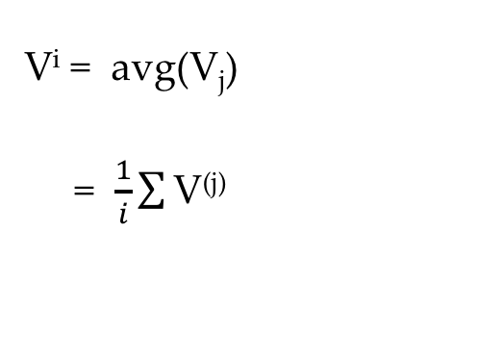
Modeling Assumptions
?
?
Click 1
Click 2
Click 3
( V₁ , V₂ ,V₃ ) → V^{i}
Pessimistic
Risk Neutral
Trust, Chance Aversion
V^{i} = avg(V_{j})
= $\frac{1}{i}\sum{\text{V}\text{(}\text{j}\text{) }}$
V^{i} = min(V_{j} )
= i^{th} order statistic, V^{(i)}
j ∊ S
j ∊ S
j ∊ S
Notes:
In this work we look at two possible models for how a customer values the opaque product, that are found in the literature, and represent two natural extremes for how you would have an opaque product.
On one hand, a customer who either mistrusts the seller or highly chance averse may value the opaque product in a worst case fashion. In particular they value it as the minimum possible valuation, V^i. This is maybe how I feel personally feel about opaque selling, and has appear.
Note, that a customer who picks their favorite k items for the opaque product, and values it at the lowest possible outcome, values the opaque exactly according to their i^th order statistic, explaining the exponential notation.
On the other hand.

Slide 22
Opaque Selling Model
N products of sizes 1 through N.
Customers draw valuations (V₁, V₂, .., V_{N}) ~ F
Price p^{i} for opaque product depends only on size.
Purchase product that maximizes utility: V^{i} – p^{i}
Values opaque products as functions of outcomes.
Pessimistic – V^{i} is equal to the minimum of outcomes.
Risk-Neutral – V^{i} is equal to the average of outcomes.
7 , 5 ,3
7 – 5.99
$ 5.99
min(7,5) - 5
$ 5
min(7,5,3) - 2
$ 2
?
?
Click 1
Click 2
Click 3
Notes:
So follow the example

Slide 23
Opaque Selling Model
N products of sizes 1 through N.
Customers draw valuations (V₁, V₂, .., V_{N}) ~ F
Price p^{i} for opaque product depends only on size
Purchase product that maximizes utility: V^{i} – p^{i}
Values opaque products as functions of outcomes.
Pessimistic – V^{i} is equal to the minimum of outcomes.
Risk-Neutral – V^{i} is equal to the average of outcomes.
7 , 5 ,3
7 – 5.99
$ 5.99
(7+5)/2 - 5
$ 5
(7+5+3)/3 - 2
$ 2
?
?
Click 1
Click 2
Click 3

Slide 24
Opaque Selling Model
N products of sizes 1 through N.
Customers draw valuations (V₁, V₂, .., V_{N}) ~ F
Price p^{i} for opaque product depends only on size
Purchase product that maximizes utility: V^{i} – p^{i}
Values opaque products as functions of outcomes.
Pessimistic – V^{i} is equal to the minimum of outcomes.
Risk-Neutral – V^{i} is equal to the average of outcomes.
Allow mixtures of customer types.
α customers are pessimistic, 1- α are risk-neutral.
Lemma: Can easily estimate α from purchase data using MLE.
Notes:
In particular, we will imagine markets that consist of mixtures of these two customer types and let al be the mixing proportion.

Slide 25
Benefit of Opaque Selling
2 different products
Customers draw valuations i.i.d.:
Customers are pessimistic (α = 1)
$ 1.99
$ 1
1 w.p. 2/3
?
V_{i} =
2 w.p. 1/3
Click 1
Click 2
(1 , 2)
(2 , 1)
(2 , 2)
(1 , 1)
?
?
E[Revenue(1,1)] = 1
E[Revenue(2,2)] ≅ 10/9
E[Revenue(2,1)] ≅ 11/9
E[Revenue(OPQ)] = 1.99・4/9 + 5/9
≅ 13/9
Notes:
To formalize how it all works, lets go back to our example
Pick instead of Click
Halo around the clicked shirt
Draw a square on each shirt

Slide 26



What should a seller do?
$ 14
$ 11
$ 9
$ 11
$ 9
$ 14
?
?
Click 1
Click 2
Click 3
(DP)
(OPQ)
V₁ , V₂ ,V₃
Notes:
So with these models set up, we’d like to beg the question: what should a seller do?
Note this comparison is fair, both are n parameters pricing strategy. They live in the same world. Their expected revenue is well defined. What should a seller do?

Slide 27
Binary Valuations
Suppose valuations are i.i.d. and supported on two values
Simple approximation for bimodal demand
High, Low, High
$ p₁
$ p₂
$ p₃
F
Notes:
So let’s start with the simplest possible valuation structure and work from there. Suppose valuations are supported on two points. It’s a rough cut that essentially says, I like these and not these. This is a kind of model that may make sense if valuations are say bimodal.
Even with this very simple valuation structure, there’s some interesting things to say about opaque selling.

Slide 28
Binary Valuations
Theorem [OPQ Dominates DP].
If valuations are i.i.d. and supported on two points, the revenue of an optimal opaque selling strategy dominates the revenue of optimal discriminatory pricing.
Proof Sketch: Let F be supported on {1,2}, N=4
1+3/4
1+1/2
1+1/4
1
1
2
2
2
?
?
?
1
2
3
4
(DP) has simple structure
(OPQ) uses many prices
Notes:
In this rough cut model, we can state our first theorem. Mention the previous model is an instance of this
To build some intution for how this result comes about, we will sketch the proof. For simplicity, assume there are 4 colors of shirts, and they’re valuations are either 1 or 2.
Note in the a discriminatory pricing model, if one of the shirts is priced at 1, everyone will buy some shirt (since the utility for the low priced item is always at least 0). As it turns out, we can assume that DP has this pricing where one item is priced low and all other items are priced high.
To prove the theorem, we construct a certain pricing for the opaque products and argue it always earns more revenue.

Slide 29
Binary Valuations
Theorem [OPQ Dominates DP].
If valuations are i.i.d. and supported on two points, the revenue of an optimal opaque selling strategy dominates the revenue of optimal discriminatory pricing.
Proof Sketch: Let F be supported on {1,2}, N=4
1+3/4
1+1/2
1+1/4
1
1
2
2
2
?
?
?
1
2
3
4
Suppose customer likes 2 items

Slide 30
Binary Valuations
Theorem [OPQ Dominates DP].
If valuations are i.i.d. and supported on two points, the revenue of an optimal opaque selling strategy dominates the revenue of optimal discriminatory pricing.
Proof Sketch: Let F be supported on {1,2}, N=4
1+3/4
1+1/2
1+1/4
1
1
2
2
2
?
?
?
1
2
3
4
Suppose customer likes 2 items,
½ chance of buying the red shirt.

Slide 31
Binary Valuations
Theorem [OPQ Dominates DP].
If valuations are i.i.d. and supported on two points, the revenue of an optimal opaque selling strategy dominates the revenue of optimal discriminatory pricing.
Proof Sketch: Let F be supported on {1,2}, N=4
1+3/4
1+1/2
1+1/4
1
1
2
2
2
?
?
?
1
2
3
4
Suppose customer likes 2 items,
½ chance of buying the red shirt.

Slide 32
Binary Valuations
Theorem [OPQ Dominates DP].
If valuations are i.i.d. and supported on two points, the revenue of an optimal opaque selling strategy dominates the revenue of optimal discriminatory pricing.
Proof Sketch: Let F be supported on {1,2}, N=4
1+3/4
1+1/2
1+1/4
1
1
2
2
2
?
?
?
1
2
3
4
Suppose customer likes 2 items,
½ chance of buying the red shirt.
If a customer likes 2 items,
buys a 2-opaque product.
Notes:
By the special structure of our prices, a customer who has high valuations for k items will always purchase a k opaque product.

Slide 33
Binary Valuations
Theorem [OPQ Dominates DP].
If valuations are i.i.d. and supported on two points, the revenue of an optimal opaque selling strategy dominates the revenue of optimal discriminatory pricing.
Proof Sketch: Let F be supported on {1,2}, N=4
1+3/4
1+1/2
1+1/4
1
1
2
2
2
?
?
?
1
2
3
4
Suppose customer likes k items,
k/4 chance of buying the red shirt.
If a customer likes k items,
buys a k-opaque product.

Slide 34
Binary Valuations
Theorem [OPQ Dominates DP].
If valuations are i.i.d. and supported on two points, the revenue of an optimal opaque selling strategy dominates the revenue of optimal discriminatory pricing.
Proof Sketch: Let F be supported on {1,2}, N=4
1+3/4
1+1/2
1+1/4
1
1
2
2
2
?
?
?
1
2
3
4
Loss from purchases of
the low valued item.
=
Loss from k-opaque discount.
Notes:
The meat of the theorem is then, that the losses from purchases of the low valued item are exactly equal to the lows from the discount.
Ideally every item would be purchased a price 2, but since that can be achieved by pricing mechanisms.

Slide 35
Binary Valuations
Theorem [OPQ Dominates DP].
If valuations are i.i.d. and supported on two points, the revenue of an optimal opaque selling strategy dominates the revenue of optimal discriminatory pricing.
The result is true for any α, N.
Binary valuations are a natural best case for discriminatory pricing.
Assumptions are tight.
Notes:
I want to highlight a few interesting insights about the theorem. Yes, the valuation structure is very simple, being supported on two points, however.

Slide 36



Binary Valuations
Theorem [1OPQ Approximates DP].
If valuations are i.i.d. and supported on two points, an opaque selling strategy with a single opaque product earns at least 71.9% of the optimal discriminatory pricing.
Theorem [OPQ Dominates DP].
If F is exchangeable and supported on two points, the revenue of an optimal opaque selling strategy exceeds the revenue of optimal discriminatory pricing.
With out the opaque product no single price can guarantee more than 50% of (DP).
Approximation is minimized when N=10, in general much better (even > 100%).
This is the dominant paradigm in practice.
p
p^{N}
?
…
Click 1
Click N
Notes:
One weakness of the previous theorem, besides the simple valuation structure, was that althought technically DP was allowed to use N distinct prices, it only needed 2 whereas OPQ needed.
People can’t see the color selected for you!

Slide 37
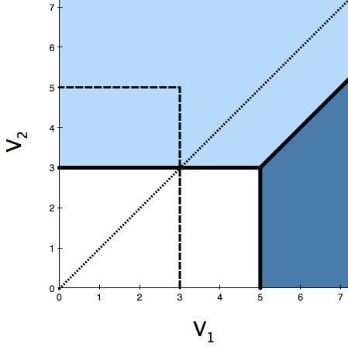
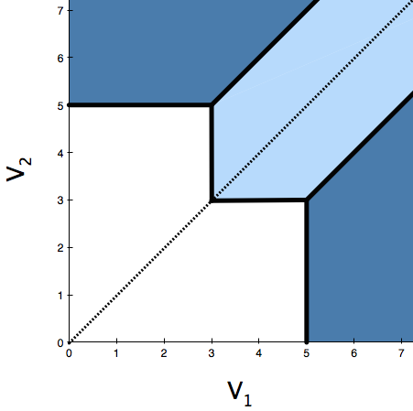
General Valuations
Theorem [OPQ Dominates DP II].
If valuations are i.i.d. and customers are pessimistic, the expected revenue of an optimal opaque selling strategy dominates the revenue of discriminatory pricing.
Proof by picture (N=2)
(DP), p₁ > p₂
(OPQ)
p₂
p²
p₁
p¹
Notes:
So we are interested in when opaque selling earns more revenue that discriminatory selling, and so far we’ve only been able to say its better when valuations are supported on two points.
The next theorem says that dominance holds much more broadly, but relys on our customer assumptions.
The proof works like this:
We can write out the valuation spaces for the two strategies that are being compared… etc etc

Slide 38
General Valuations
Theorem [OPQ Dominates DP II].
If valuations are i.i.d. and customers are pessimistic, the expected revenue of an optimal opaque selling strategy dominates the revenue of discriminatory pricing.
Proof by picture (N=2)
(DP), p₁ > p₂
(OPQ)
V₁ > V₂
p₂
p²
p₁
p¹
Notes:
One can show that when the valuation the higher priced item exceeds the valuation for the lower prices item, a DP strategy earns more money. Further, one can construct an opaque strategy that has exactly the same allocations and revenue as DP when V1 > V2
Yellow Triangle to Yellow Triangle, mirroring
Fucking triangles

Slide 39
General Valuations
Theorem [OPQ Dominates DP II].
If valuations are i.i.d. and customers are pessimistic, the expected revenue of an optimal opaque selling strategy dominates the revenue of discriminatory pricing.
Assumptions are tight.
Remarks
The result is true for any α, N
Binary valuations are a natural best case for discriminatory selling [Dutting (’16)]
Assumptions are tight
Implication: Sellers can earn more when customers are mistrustful.
Despite risk-neutral customers have strictly higher valuations for the opaque product than pessimistic customers.
Notes:
Implication is a little counter intutive.
That’s very interesting in practice, one natural fear when introducing a new pricing technology is that it will be poor received or mistrusted. It turn out this is great news for opaque selling!

Slide 40
Beyond Independence
Definition (informal): We call F is exchangeable and if every order of valuations is equi-probable.
Captures location based models like Hotelling, Salop’s Circle (N=3)
Salop’s Circle
V₃
3
Not i.i.d.
Products
1
2
Notes:
So so far we have dominace when valuaitons are iid and either all customers are pessistic or binary. It turns out we can push the result further by considering whats known as exchanageble distributions.
Exchangeable allows for corrolation between items which may be natural, while still preserving the essential symmetry that powers our results. In particular, it may be that everyone who likes pink dislikes blue and vice versa.
Further exchangeability lifts our results to many contexts that are relevant in the literature, for example Salops circle

Slide 41
Beyond Independence
Theorem [OPQ Dominates DP III].
If F is exchangeable and customers are pessimistic or valuations are binary, the expected revenue of an optimal opaque selling strategy dominates the revenue of discriminatory pricing.
Salop’s Circle
V₃
3
Not i.i.d.
Products
1
2
Notes:
Color missing, motivate it, give the model

Slide 42
Beyond Independence
Theorem [OPQ Dominates DP III].
If F is S-exchangeable and customers are pessimistic or valuations are binary, the expected revenue of an optimal opaque selling strategy dominates the revenue of discriminatory pricing.
Salop’s Circle
V₃
3
Not exchangeable for N > 3! For N items, only 2N possible valuation orderings.
Products
1
2
Notes:
Color missing, motivate it, give the model

Slide 43
General relation between OPQ and DP
Theorem [OPQ is comparable to DP when i.i.d.].
If F consists of N i.i.d. draws, the expected revenue of an optimal opaque selling strategy is no more than 4 times the optimal discriminatory pricing.
Theorem [OPQ is incomparable to DP].
If F is exchangeable, the expected revenue of an optimal opaque selling strategy can earn N times more than the optimal discriminatory pricing.
Key Takeaway
Opaque selling can exploit dependency across goods better than discriminatory pricing.
Notes:
Finally, lets conclude with what we can say when we are not in the cases described it. In particular, if the customers are not all pessimistic or supported on two points.
When valuations are i.i.d., the strategies are relative close to one another, within constant factors which is quite helpful.

Slide 44
Simulation Results
Algorithm
If F be exchangeable and supported on m points, then both the optimal opaque pricing and discriminatory pricing can be computed in O(m^{N}).
MIP
When N is large the problem can be formulated as MIP and solved.
Hardness:
When valuations are i.i.d. finding optimal prices is strongly NP-Hard [Chen et al. (2018)].
For general valuations the pricing problem is inapproximable.
Notes:
So that was the theory, let’s see how far our results extend for some classic test distributions.
Before we jump into the numerics, let’s take a moment to talk about algorithms for these problems. So far we’ve been able to prove existential results about when opaque selling dominants, to actually observe the effects we need to compute the optimal price vectors.
Just think about it a little more, spend a little less time.

Slide 45
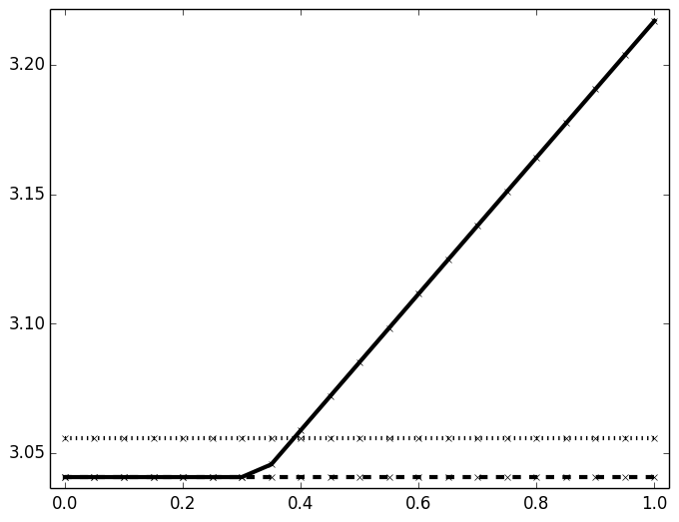
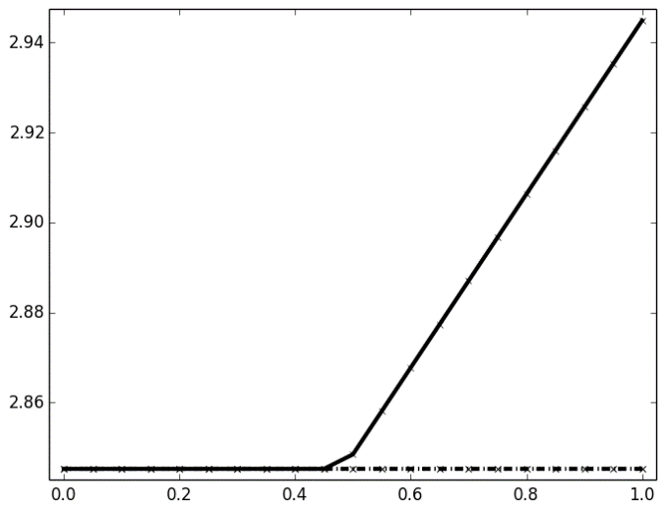
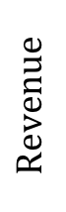
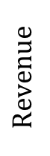
Simulation Results
N=2, F i.i.d. Triangular
N=2, F i.i.d. Normal
$$Revenue$$
OPQ
$$Revenue$$
OPQ
DP
SP
DP = SP
Risk-Neutral
α
Pessimistic
Risk-Neutral
α
Pessimistic
As percentage of pessimistic customers increases so does OPQ
OPQ and DP are generally incomparable
OPQ can extract additional revenue even when DP = SP
Notes:
Let’s look at the revenue under these distributions as al, the percentage of customers who are risk neutral in the market
Change the format of the slide. Numerics go up top, the rest go down below.

Slide 46
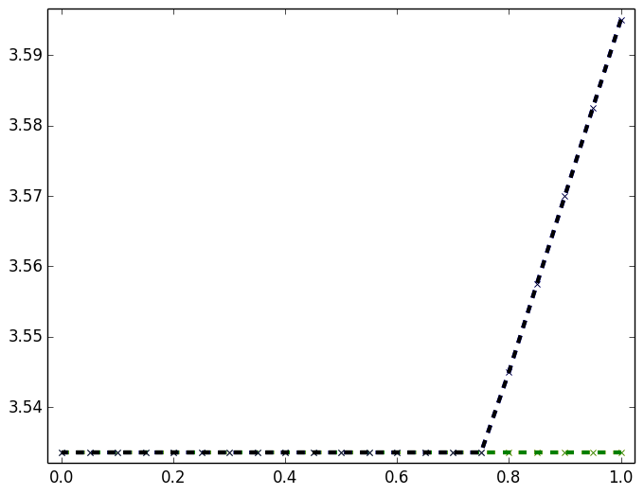
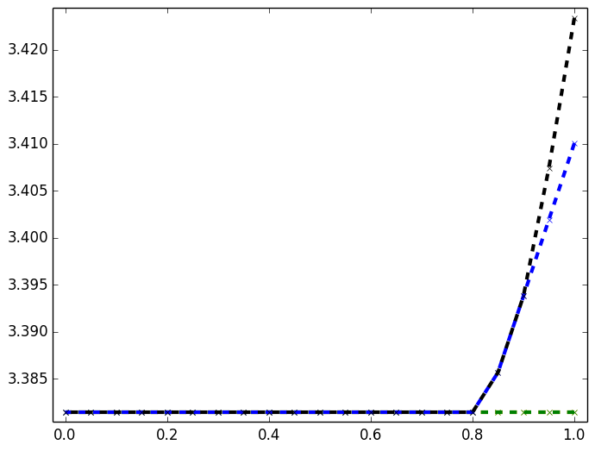
Simulation Results
N=3, F i.i.d. Triangular
N=3, F i.i.d. Normal
OPQ
$$Revenue$$
OPQ = 1OPQ
$$Revenue$$
1OPQ
DP = SP
DP = SP
Risk-Neutral
α
Pessimistic
Risk-Neutral
α
Pessimistic
One opaque product (1OPQ) can capture much of the revenue.
But not all the revenue!
Notes:
Let’s look at the revenue under these distributions as al, the percentage of customers who are risk neutral in the market
Change the format of the slide. Numerics go up top, the rest go down below.

Slide 47
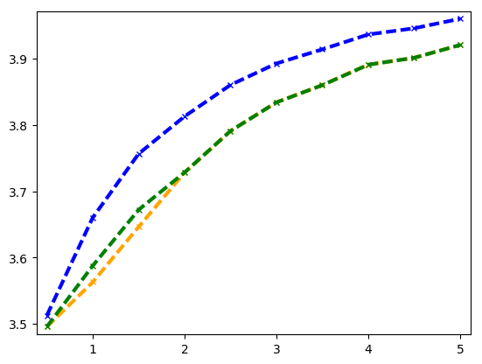
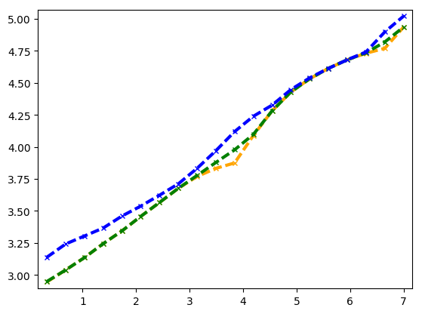
Simulation Results
N=3, F i.i.d. Triangular, α = 1
N=3, F i.i.d. Normal, α = 1
OPQ
DP
OPQ
SP
$$Revenue$$
$$Revenue$$
SP
DP
Variance
Variance
Revenue tends to increase as the variance increases
Relative gap between pricing strategies remain constant.
Notes:
Let’s look at the revenue under these distributions as al, the percentage of customers who are risk neutral in the market
Change the format of the slide. Numerics go up top, the rest go down below.

Slide 48
Thank you
Questions and comments: mh3461@columbia.edu
Works referenced are available at: https://mhamilton-pitt.github.io/
Notes:
Ending is abupt, need ot transiton slower
Speaking too too fastr
Too much set up
Fucked up proof by picture
Market segmentation stuff all needs to go
Mention optimal prices versus one that’s constructed
Do I characterize the optimal prices for opaque thigns
Describe it if it’s easy – more details, meat etc
More on the customer assumpttions for loot boxes
This set up needs more motivatation

